Slide 1

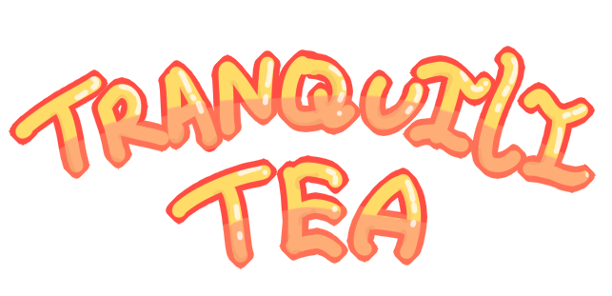
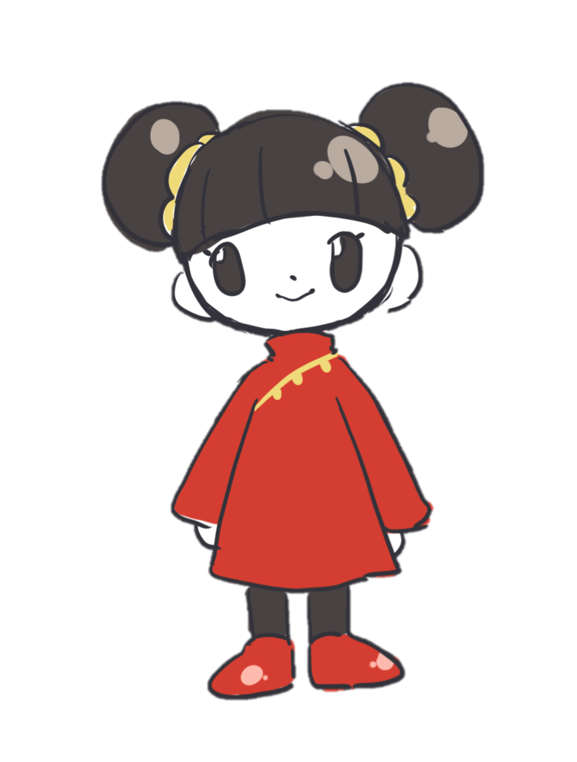
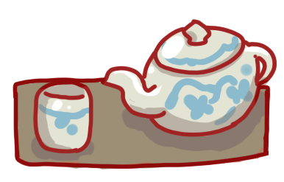
Ashley Vargas, Karina Vargas, Christina Cuneo, and Rachel Lau

Slide 2
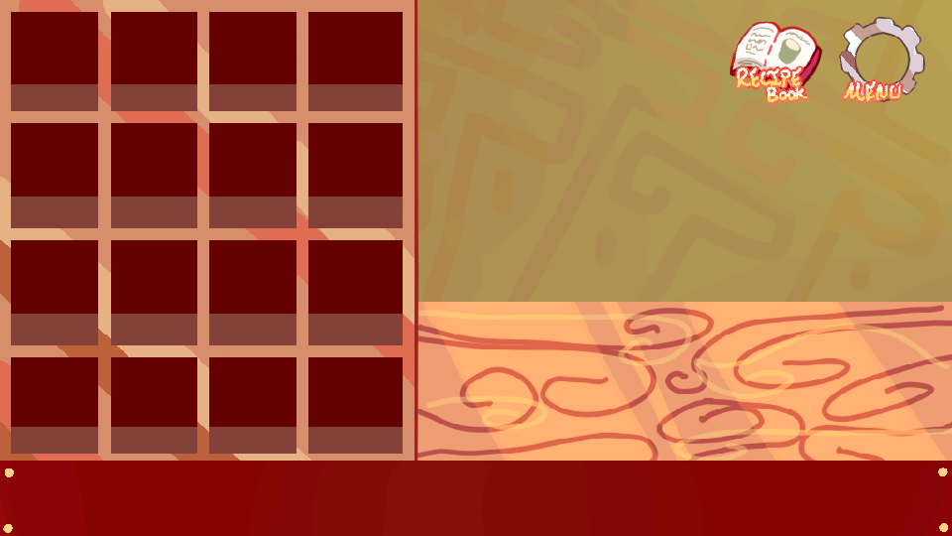
Before

Slide 3

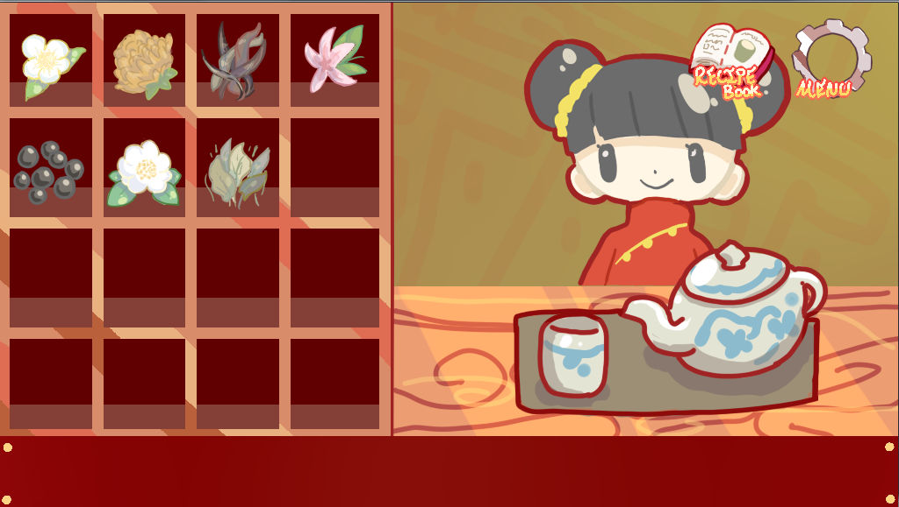
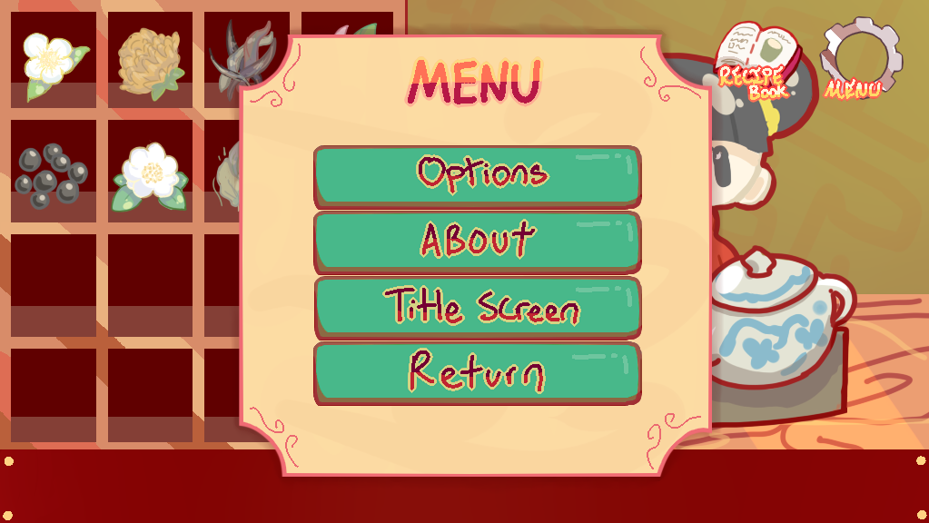
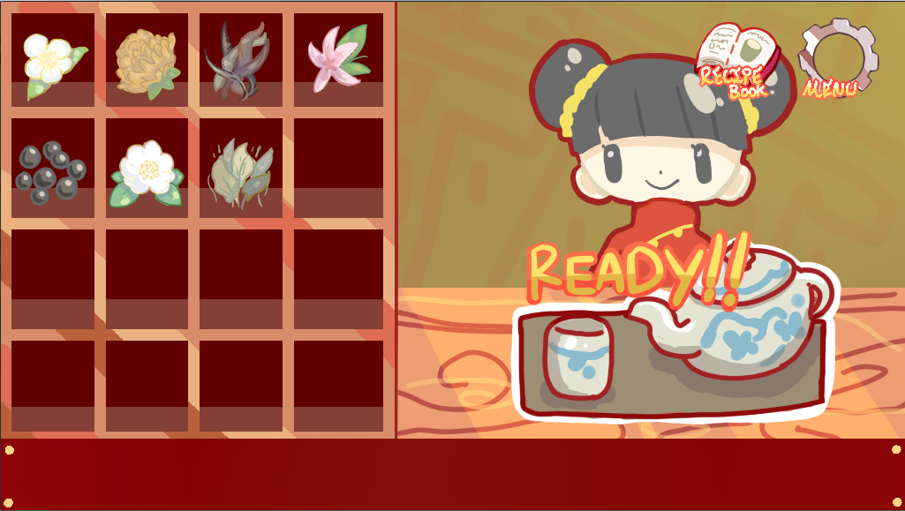

Screenshots of our app

Slide 4
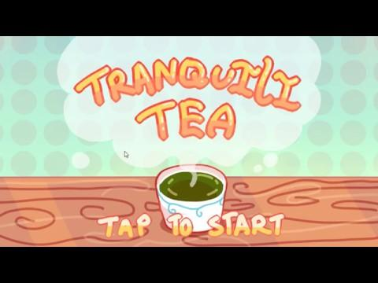
Video:

Slide 5
Retrospective
6 user stories planned, 5.5 completed.
Did not complete all the ingredients.
Team should start to communicate more.
Team should procrastinate even less.
Continue working at the pace the we are working.

Slide 6
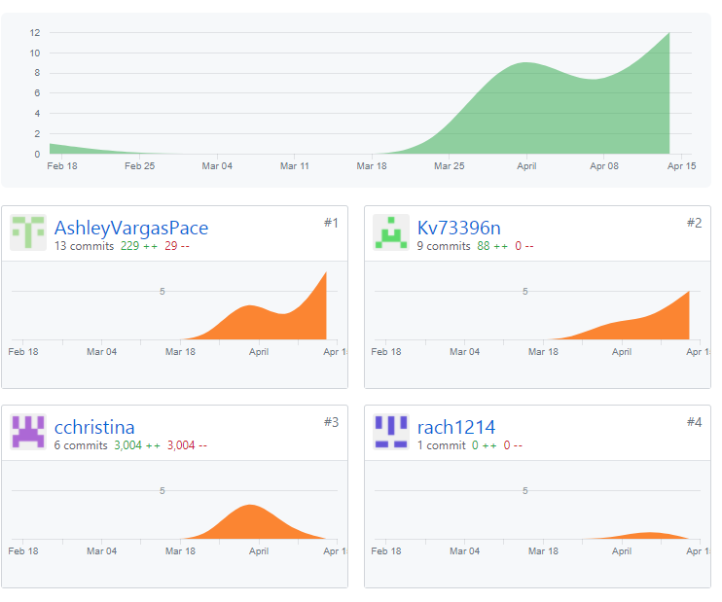
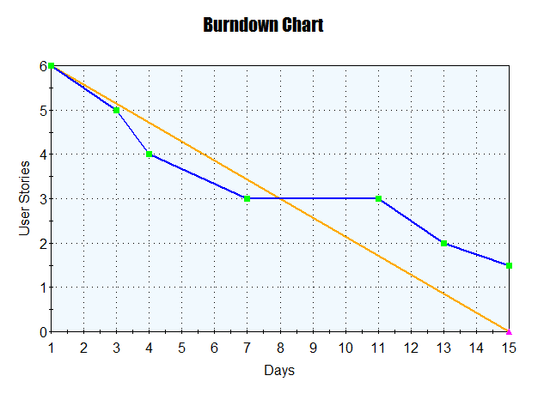
Stats and Burndown

